Slide 1
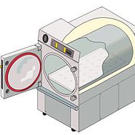
Autoclave Validation & Documentation
M M N Pradeep

Slide 2
Invention
The autoclave was invented by Charles Chamberland in 1879.
The Name comes from Greek auto- ultimately meaning self, and Latin clavis meaning key, thus a self-locking device.

Slide 3
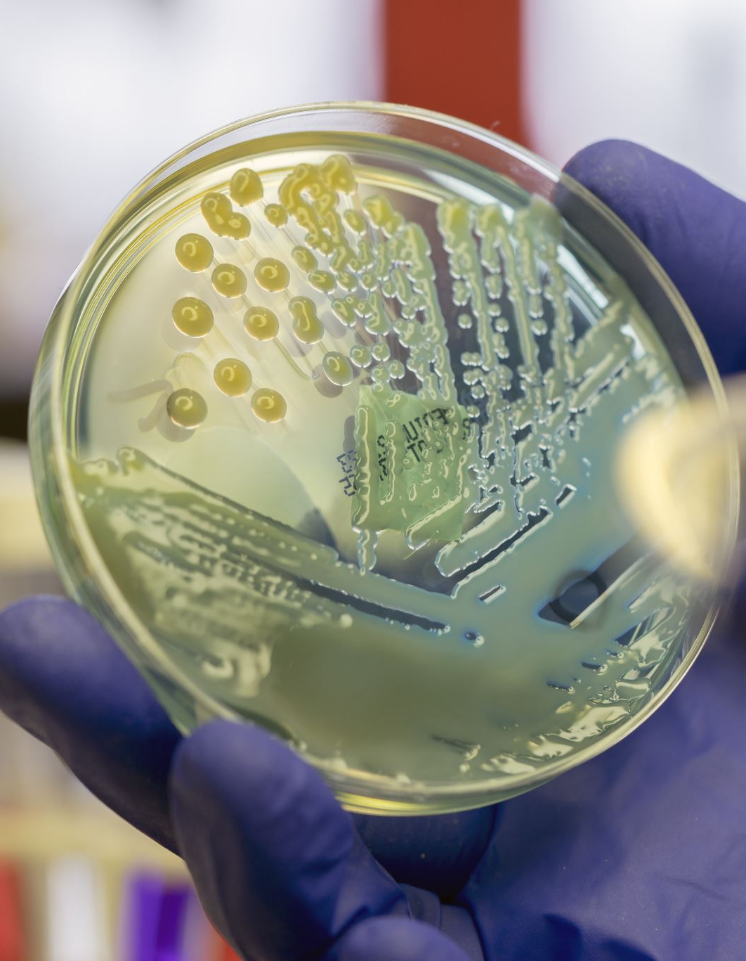
Working principal
An autoclave is a device that works on the principle of moist heat sterilization, wherein saturated steam is generated under pressure in order to kill microorganisms such as bacteria, viruses.

Slide 4
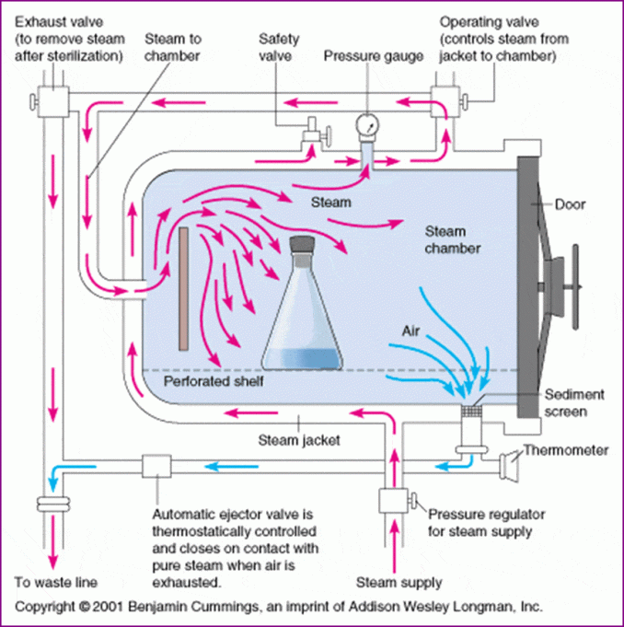
Basic Design of Autoclave

Slide 5
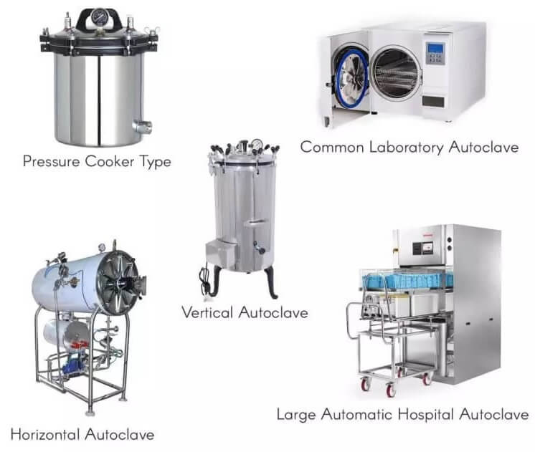
Types of Autoclaves

Slide 6
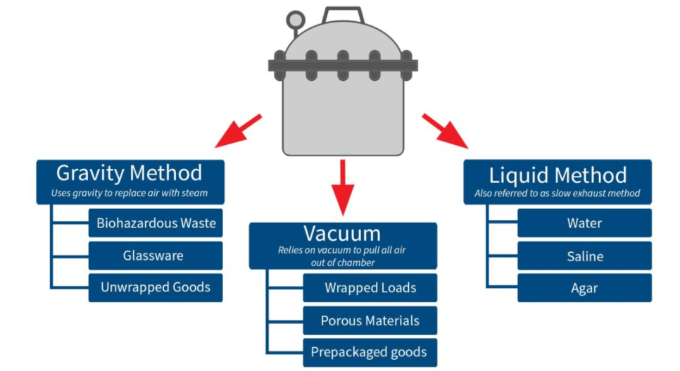
Different Methods in Autoclave

Slide 7
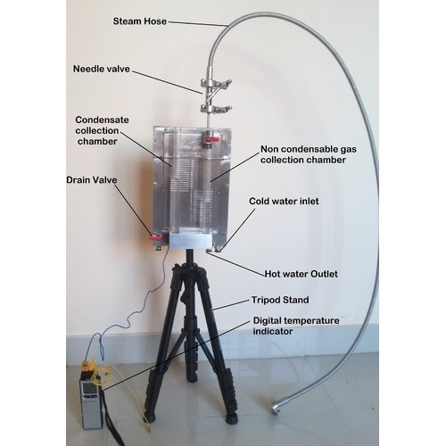
Autoclave Validation
Following Test should be performed in Autoclave Validation:
1. Pure steam quality test :
A) Non- condensable gas: NMT 3.5%.
B) Superheat test: NMT 25°C.
C) Dryness test: NLT 0.95.
D) Chemical & microbiological tests

Slide 8
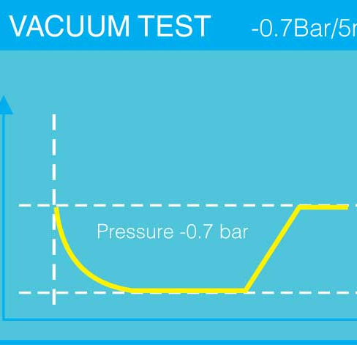
2. VLT : To determine the air-tight integrity of an autoclave's chamber and plumbing system. Limit NMT 1.3 mbar/min.

Slide 9

3. Bowie-Dick test: Tests evaluate the performance of pre-vacuum autoclave by confirming adequate air removal from the autoclave chamber.

Slide 10
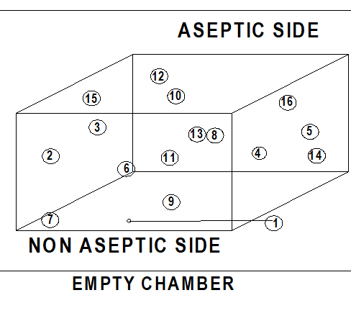
4. Empty chamber heat distribution study : To verify the temperature uniformity throughout the chamber and to locate the cold and hot spot. The sterilizer is capable attaining a temperature of 121º C to 124º C throughout the sterilizing hold period.

Slide 11
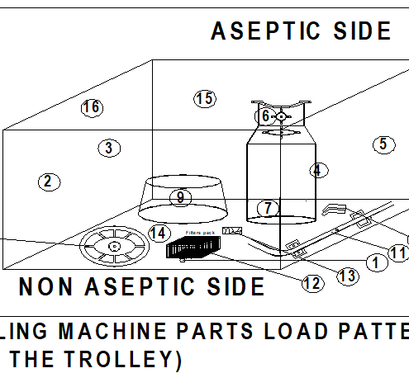
5. Loaded chamber heat distribution and penetration study: The purpose of developmental & heat penetration study is to identify the critical and key operating parameters that will be result in a product or material sterile and functional after being sterilized.

Slide 12

Documentation
The equilibration time for 800 litres autoclave 15 second and more than 800 litres 30 second.
During sterilization hold period all temperatures measured in the chamber shall be within the range of 121.0°C to 124.0°C.
During sterilization hold time the temperature measured should not differ from one probe to another probe by more than 2°C.
During sterilization hold time the temperature measured within the probe does not fluctuate by more than ±1°C.
F0 value Not less than 30 minutes.

Slide 13

PDA (Parenteral Drug Association) Technical Report No. 48 (TR 48): Moist Heat Sterilizer Systems: Design, Commissioning, Operation, Qualification and Maintenance.
EN (European Standard)285:2015 Sterilization.

Slide 14
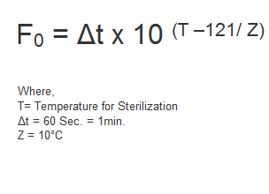
Protocol
1. Load pattern.
2. Hot spot & Cold spot determinisation.
3. Sterile temperature hold time determinisation.
4. Equilibration time determinisation.
5. Lethality f0 Value determinisation.

Slide 15
Summary Report
Run wise lethality determinisation of each equipment.
Find the average lethality of each sensor in 3 penetration runs.
Find the Worst-case equipment.

Slide 16

Thank you

